Slide 1
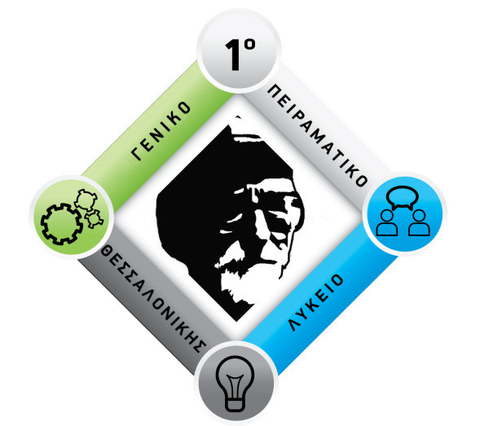
COPYRIGHT & PATENTSHIP IN GREECE
1st Experimental High School of Thessaloniki
“Manolis Andronikos”
Erasmus KA2+
Inventors and Innovators: our heritage and our future
Oikonomou-Petrovits, Dimitra
Koutsikakis, Dimitrios
Mavrogiannidi, Thelia
Tsamopoulou, Antonia

Slide 2
COPYRIGHT – What can we protect ?
Copyright protects all original intellectual literary, artistic or scientific creations, expressed in any form, and especially:
written or oral texts
musical compositions with or without text
theatrical plays with or without music
choreographies and pantomimes
audiovisual works
fine art works etc
Computer programs and databases etc.

Slide 3
No formal procedure or the collaboration of a governmental or non-governmental ​service ​is required for the recognition of author’s rights on a work, as ​it ​is the case for the acquisition of rights on other intangible assets (e.g. registering a trademark).

Slide 4
Ways to secure the author and to make sure that there is an element ​of proof of paternity
deposit of the ​Intellectual ​work to a notary → provides ​a rebuttable presumption confirming the date, which can be evaluated by Court in the event of legal proceedings on the violation of the rights on that work.​
postage of a registered letter whose sender and recipient is the author himself (​or the recipient can be a third person)​. On receiving the letter which contains the work, the author stores it in a safe place and keeps it sealed. In case a dispute about this specific work ever occurs the letter will be unsealed by a judge before ​the Court and will confirm its content.

Slide 5
Rights that copyright law provides
The right to record the work, i.e. the right for its first integration onto a data carrier consisting the basis for its further reproduction
Reproduction of the work, i.e. the production of one or more copies of this work
Translation
Adaptation, customization or other alteration
The authority to distribute the original work

Slide 6
Rights that copyright law provides
The import of its copies that were produced abroad
Rental and public lending
Public performance, i.e. any performance that makes the work available to a number of people greater than close family members and immediate social environment
Broadcasting from the radio or television
Cable, wireless or other type of presentation to the public (broadcasting the work over the Internet)

Slide 7
Related rights
Besides the protection of the authors, technical progress has created the need to protect:
artists who render or perform
producers of audio and/or video data carriers
broadcasting organization
publishers of printed documents, responsible for typesetting and pagination
persons publishing unpublished works by authors who are no longer alive databases manufacturers

Slide 8
Duration
Copyright lasts for all the author’s life and seventy (70) years after his death, starting on January 1st of the year after the author’s death
Related rights: The duration of the related rights of performers or performing artists is set to fifty (50) years after the date of the performance but it cannot be shorter than the lifetime of the artist.

Slide 9
Ways to protect author’s rights
Civil and criminal penalties: Civil penalties provide the rightholder's right to compensation for the violation of his rights, which cannot be less than double the fee usually or legally paid for the exploitation that the offender carried out without permission.

Slide 10
PATENTSHIP
The Hellenic Industrial Property Organisation is the only legally qualified institution for the protection of inventions and industrial designs. It also provides technological information from worldwide patent databases.

Slide 11
PATENTSHIP
A Patent is a title of protection valid for 20 years issued to the proprietor for an invention which is new, involves an inventive step and is capable of industrial application.
These inventions may either be products, product manufacturing methods or industrial applications.

Slide 12
PATENTSHIP
Criteria for granting a patent:
A) It must be new, that is it must fall outside of the existing state of the art.
The state of the art includes everything which is known anywhere in the world from written or oral description or in any other manner by any person before the filing date of the patent application (or the priority date claimed by the applicant).

Slide 13
PATENTSHIP
2 exceptions:
The invention was disclosed within a period of 6 months before the patent application filing date and there was abusive conduct detrimental to the applicant or his assigns.
The invention was disclosed within the 6 months before the patent application filing date by the inventor or his assigns by presenting it at an officially recognised exposition within the meaning of the International Expositions Convention (Paris Convention of 22nd November 1928).

Slide 14
PATENTSHIP
B) It is considered as involving an inventive step that is, in an expert’s opinion, it is not based on the existing state of the art in any obvious manner.
C) It is capable of industrial application where it can be produced and used in any field of industrial activity.

Slide 15
PATENTSHIP
A patent is NOT granted in cases such as:
Discoveries, scientific theories and mathematical methods.
Surgical methods and courses of treatment for the human body or animals’
Plant varieties, animal species or biological methods for reproducing plants or animals.

Slide 16
PATENTSHIP
Works of art / literature, etc.
Computer programs
Inventions whose publication or application is contrary to public order or morals.

Slide 17
THANK YOU FOR YOUR ATTENTION!
Thelia Mavrogiannidi
Dimitra Oikonomou Petrovic
Dimitrios Koutsikakis
Antonia Tsamopoulou

