Slide 1
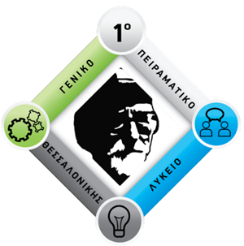
"Inventors and innovators: our heritage and our future"
By Boutiou Sofia Stefania
1st Experimental High School of Thessaloniki
«Manolis Andronikos»

Slide 2
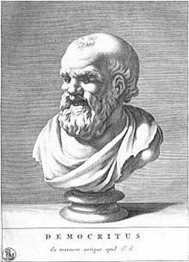
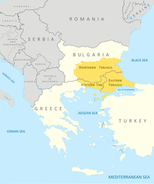
Democritus
~ About his life
Born: 460 BC in Abdera, Thrace
Died: 370 BC (aged around 90)
Main interests: Metaphysics, Mathematics, Astronomy
(as he was an Ancient Greek pre-Socratic philosopher)
Notable ideas: Atomism, Aetiology etc.
“Many consider Democritus to be the "father of modern science".”

Slide 3
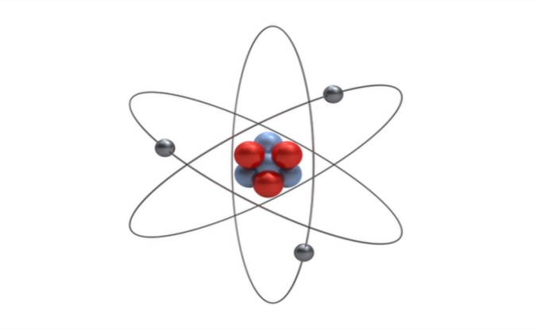
Atomism
~A Few Words
Atomism (from Greek ἄτομον) is a natural philosophy that developed in several ancient traditions. The atomists theorized that nature consists of two principles:
atom and void.
In atomic theory, atoms come in an infinite variety of shapes and sizes, each indestructible, immutable and surrounded by a void where they collide with the others or hook together forming a cluster.
Clusters of different shapes, arrangements, and positions give rise to the various macroscopic substances in the world.

Slide 4
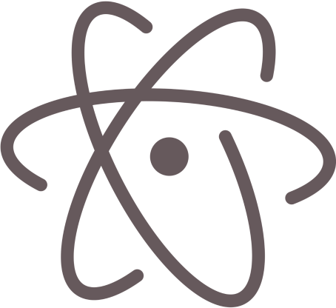
Democritus
~Atomic hypothesis
The theory of Democritus held that everything is composed of "atoms", which are:
Physically
Not geometrically
Indivisible
Between atoms, there is empty space.
These atoms are indestructible, and have always been and always will be in motion. Moreover, the atoms differ in shape and size.
"The more any indivisible exceeds, the heavier it is".
But his exact position on atomic weight is disputed.

Slide 5
Democritus
~Atomic hypothesis
Democritus, along with Leucippus and Epicurus, proposed the earliest views on the shapes and connectivity of atoms. They reasoned that the solidness of the material corresponded to the shape of the atoms involved. Thus,
Iron atoms are solid and strong
Water atoms are smooth and slippery
Salt atoms, because of their taste, are sharp and pointed
Air atoms are light and whirling (pervading all other materials).

Slide 6
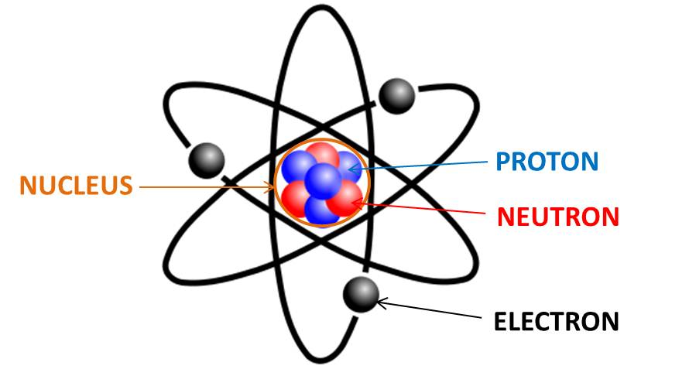
Atomic Theory
~Today’s Fact
Although scientists now believe that:
Atom is the smallest particle that can be called an element.
All materials are made up of atoms.
An atom is made of Protons (⁺), Neutrons (0) and Electrons (⁻).

Slide 7
Sources
https://en.wikipedia.org/wiki/Democritus
https://en.wikipedia.org/wiki/Atomism
Google pictures

Slide 8
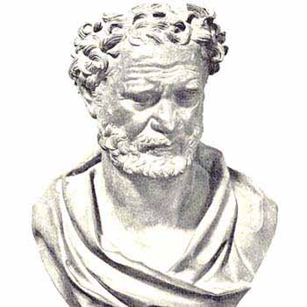
Thank you very much!

