Slide 1
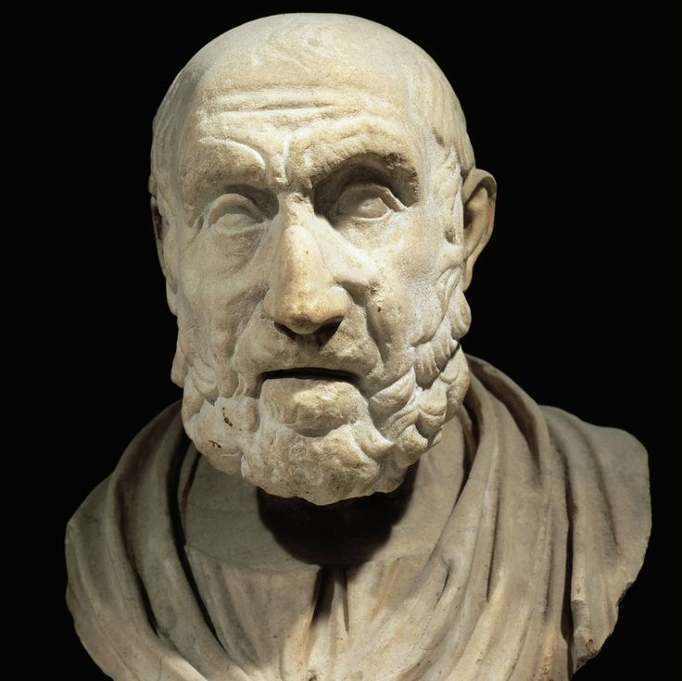
HIPPOCRATES THE FATHER OF MEDICINE
"Inventors and innovators: our heritage and our future"
Arsenios Kleon Chriskos

Slide 2
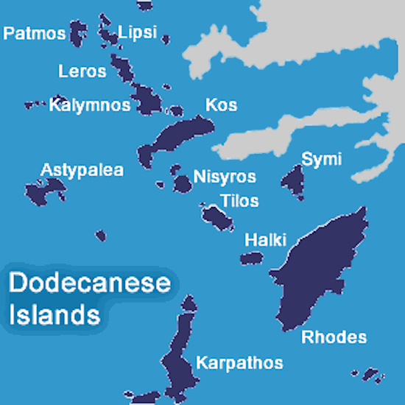
EARLY LIFE
His formal name was Hippocrates Asclepiades, meaning "descendant of (the doctor-god) Asclepios.“
Born on the Aegean island of Cos
around 460 B.C. he lived during
the age of Pericles
His father was a physician-priest
in the Asclepion at Cos and his
family could trace its lineage back
to the legendary Asclepios.
Hippocrates lived a very long life and died at a ripe old age (90 years old!) in the town of Larissa (370 B.C.)

Slide 3
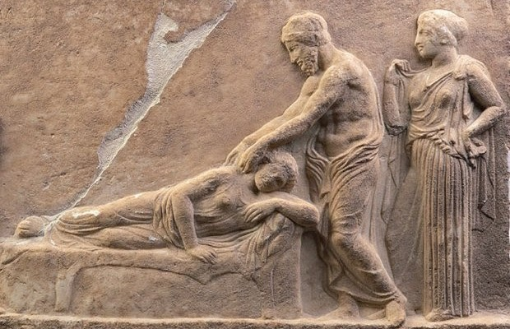
A PIONEER IN ANCIENT TIMES
The first physician to systematically classify diseases based on points of similarity and contrast between them.
He virtually originated the disciplines of etiology and pathology.
Hippocrates freed medicine from the shackles of magic, superstition, and the supernatural.

Slide 4
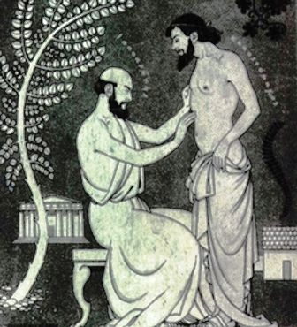
The Hippocratic Revolution
Hippocrates collected data and
conducted experiments to show
that disease was a natural process;
that the signs and symptoms of a disease were caused by the natural reactions of the body to the disease process; and that the chief role of the physician was to aid the natural resistance of the body to overcome the metabolic imbalance and restore health and harmony to the organism.

Slide 5
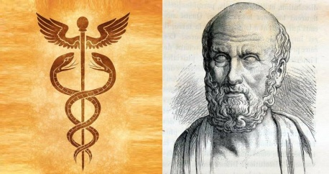
Hippocratic Medicine
He claimed that there are three substances in the human body that he called blood, mucus, yellow or black bile.
The human health depends on the balance of these substances.
Balance of substances = healthy man
Unbalance of substances = mentally and physically ill man

Slide 6
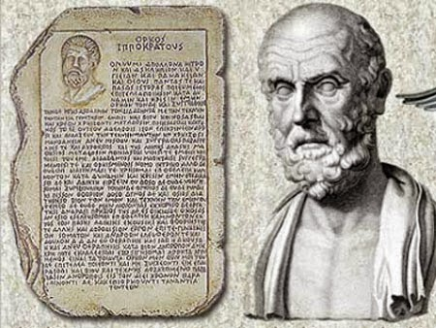
The Hippocratic Corpus 1
By systematically classifying diseases, Hippocrates placed their diagnosis and treatment on a sounder footing. Much of what is known about these methods comes from a collection of more than 60 medical books known as the Hippocratic Corpus, considered the oldest writings on medicine.

Slide 7
The Hippocratic Corpus 2
According to the Corpus, Hippocratic medicine recommended a healthy diet and physical exercise as a remedy for most ailments. If this did not reduce sickness, some type of medication was recommended. Plants were processed for their medicinal elements.
The Corpus also describes how joints could be repositioned, the importance of keeping records of case histories and treatments, and the relationship between the weather and some illnesses.

Slide 8
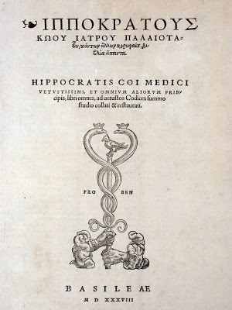
THE HIPPOCRATIC OATH
Hippocrates was the personification of the ideal physician - wise, caring, compassionate and honest. He is most remembered today for his famous Oath, which set high ethical standards for the practice of medicine. His exemplary life has been a constant and enduring source of inspiration for doctors and healers down through the ages.

Slide 9
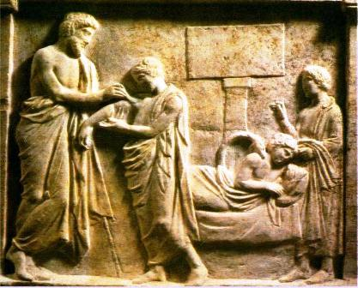
HIPPOCRATE’S GREATEST INNOVATIONS
Hippocrates was the first to develop medicine and strictly define its limits from philosophy.
According to Hippocrates, a “good” doctor ought to :
reject all kind of superstition
(most important of all) be moral.

Slide 10
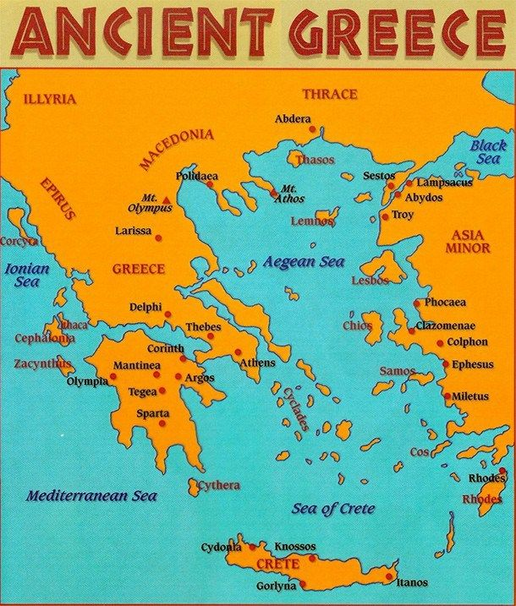
HIPPOCRATE AS A TEACHER
Hippocrates taught Medicine.
First of all he taught it to his sons.
After that, he was the first to pass on the knowledge of medicine as a school subject.
Thanks to him the science of medicine spread all over Greece

Slide 11
WISE WORDS FROM A WISE SCIENTIST

Slide 12
WISE WORDS FROM A WISE SCIENTIST
“The natural healing force within each of us, is the greatest force in getting well”
“Wherever the art of Medicine is loved, there is also love for Humanity”
~Hippocrates

Slide 13
Resources
Resources: Lipourlis Dimitrios (Hippocratic Medicine, 1983), Paratiritis Editions
Lipourlis Dimitrios (Ancient Authors, 2000),Zitros Editions, Thessaloniki,
Jouanna J. (Hippocrates, 1998) Kardamitsas Edition Athens,
Maniatis St. (History of medicine, 2002) “Entos” Editions

