Slide 1
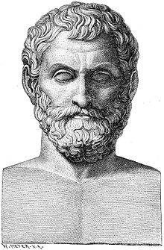
Thales of Miletus
Made by: Irene Palaiopoulou
1st Experimental Lyceum of Thessaloniki “Manolis Andronikos”

Slide 2
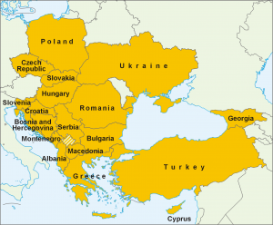
Brief biography
Born: c. 624 B.C. in Miletus, in Asia Minor
Died: c. 546 B.C. (aged c. 78)
He was a Greek philosopher (the first of the Seven Sages), mathematician and astronomer
He is recognized as the first philosopher in Greek tradition and the first individual in Western civilization to have engaged in scientific philosophy.

Slide 3
Why is he important?
1. Mythology → Science (explaining the world by theories and hypotheses)
Most famous cosmological position: the originating principle of nature is
water

Slide 4
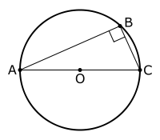
Why is he important?
2. Mathematics-geometry: He is the first known individual to whom a mathematical discovery has been attributed.
Thales’ theorem: “If A, B, and C are distinct points on a circle where the line AC is a diameter, then the angle ∠ABC is a right angle”

Slide 5
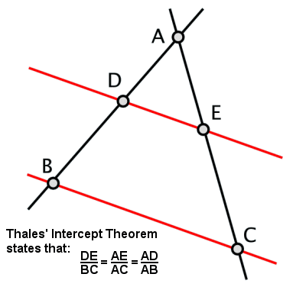
Intercept theorem: “If two intersecting lines are cut by parallel lines, the line segments cut by the parallel lines from one of the lines are proportional to the corresponding line segments cut by them from the other line” ^{[2]}

Slide 6
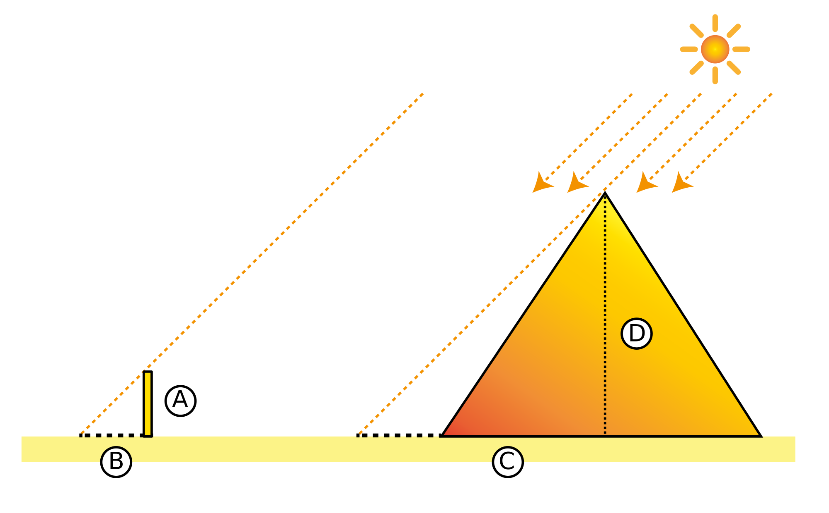
He found the height of the Great Pyramid of Giza by comparison between the lengths of the shadows cast by a wooden stick and by the pyramid.

Slide 7
Why is he important?
3. Astronomy: He predicted the solar eclipse of May 28, 585 B.C.

Slide 8
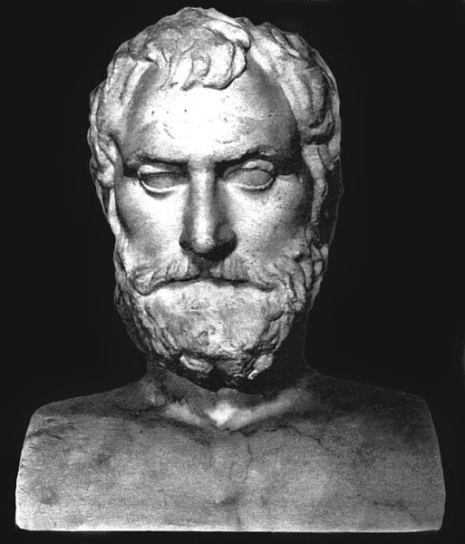
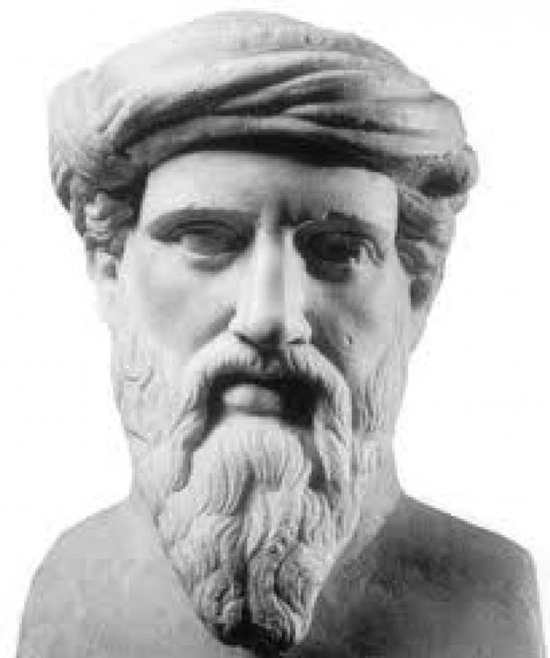
Influence on others
Thales had a great influence on other Greek thinkers (e.g. Anaximander, Pythagoras) and therefore on Western history.
Anaximander
Pythagoras

Slide 9
Sources
1. https://en.wikipedia.org/wiki/Thales_of_Miletus
2. http://planetmath.org/intercepttheorem
3. https://en.wikipedia.org/wiki/Thales%27s_theorem

