Slide 1
Eleni antoniadou
By: Eva Mystakidou, Vasiliki Charisi, Eleftheria Chondrogianni

Slide 2
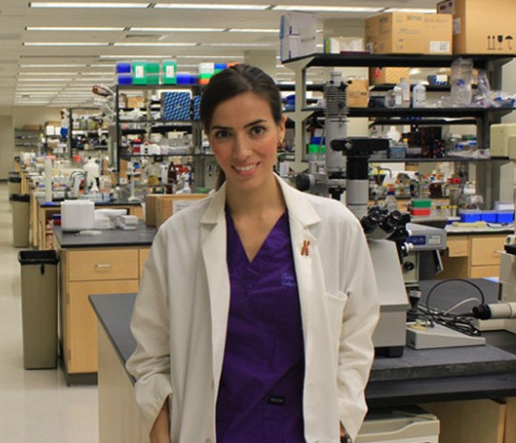
Intoduction
Eleni Antoniadou was born in Thessaloniki in 1990 and began her undergraduate studies in Greece with the subject of “Informatics with Applications in Biomedicine” at the university of Thessaly.

Slide 3
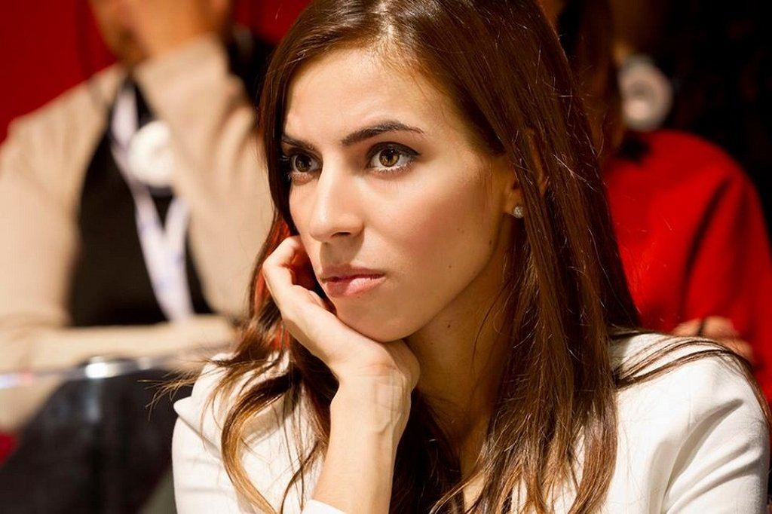
Introduction
In 2013, Eleni was named Woman of the Year at the 2013 British FDM Everywoman in Technology Awards.
She continued her postgraduate studies in the subject “Industrial”, “Nanotechnology and Anaerobic Medicine” and in Business Administration for life scientists” at the university of Thessaly

Slide 4
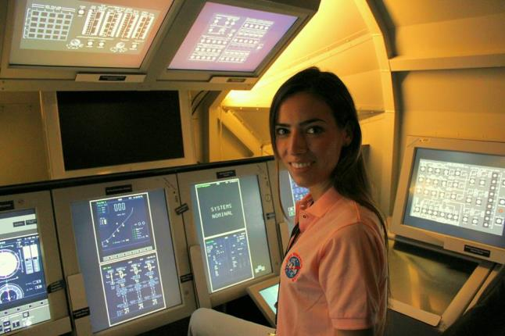
Work
She was chosen to study at the NASA Academy and worked in the Exploration Laboratory of Planet Mars regarding the field of nanotechnology and synthetic biology as well as in the astronaut training department for biomedical experiments.
Transplants Without Donors aims to create research tools for the generation of artificial organs and their clinical practice as an alternative treatment to transplants

Slide 5
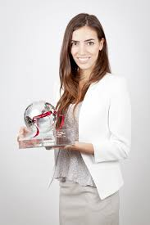
In 2009 she was chosen to work with a research team with some of the best scientists in modern medicine. Eleni, along with her fellow student, Claire Crowley, created an artificial trachea and a business plan to be able to research on it. Their goal was to main it a clinical product. This study won the first prize at University College London.

Slide 6
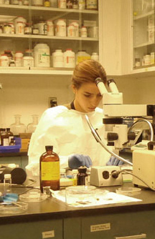
Somewhere else in England, a 36-year-old end-stage cancerous learned about the work of the two students, which were literally their last hope. He communicated with them and asked for a transplantation of the artificial trachea. Although no in vivo testing had yet been done, the patient was willing to take the risk. The surgery took place a few months after the patient was saved.

Slide 7
SOURCES
http://www.tilestwra.com/ellinida-pou-theli-na-allaxi-tin-iatriki-gia-panta-ke-ine-molis-27-eton/
http://newpost.gr/ellada/586744/elenh-antwniadoy-h-ereynhtria-poy-katekthse-th-nasa-kai-apogeiwse-thn-ellada
https://www.patrasevents.gr/article/185052-dr-eleni-antoniadou-mia-ellinida-ereunitria-sti-lista-tou-forbes-pics
http://www.startup.gr/index.php?about=89&id=502

