Slide 1
Charalambos ioannou
1st Experimental High School of Thessaloniki “Manolis Andronikos”
Erasmus-Inventors and Innovators: our heritage and our future
The exoskeleton glove
Γιάγκου Αθηνά-Ντελή Μαρία-Ντελή Δέσποινα-Παπίτσα Πολυτίμη-Χριστίνα

Slide 2
Introduction
It is common knowledge that a great many of acknowledged scientists had a flair for creating new devices even from adolescence proving that there is no age limit to ingenuity. Young inventors, who are passionate about science and technology, have managed, thanks to their innovative ideas, to greatly contribute to the effective solution of many problems in humanity’s best interests. Among these teenage bright minds we can undoubtedly find Charalambos Ioannou.

Slide 3
A few words about the inventor
Charalambos Ioannou is a Greek inventor, in the age of 17 he created an exoskeleton glove which supports and enhances the movement of the human palm so as to help people suffering from either acquired or congenital upper arm disabilities.

Slide 4
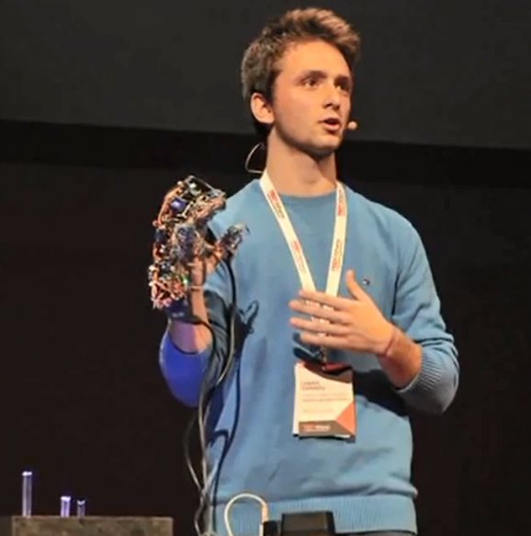
The history of the invention
The inventor came up with the idea of the exoskeleton glove after realizing that his grandmother had difficulty to catch the TV remote control.
As Charalambos confessed “One day I saw my grandmother trying to grasp the television's remote control and it was sliding from her fingers, since she suffers from an chronic upper hand disability. This stimulated me, to sit and wonder whether I could make a device in order to help her. After doing some research I found out that was not any device that its intended neither for everyday use, nor in rehabilitation centers. Thereby I asked myself what is finally the aim of technology if it is unable to solve such a basic problem.”

Slide 5
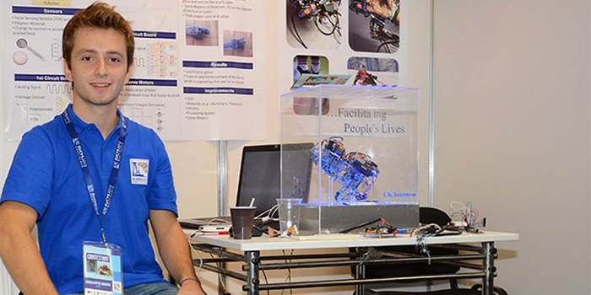
What the inventor said
“When it comes to a health problem either a millionaire or one at risk of poverty, whether black or white, young or old the problem remains the same. Taking into consideration that almost 85% of the devices used for everyday needs require at least the use of one or two hands, I deduced that such a device was crucial. Therefore I envisioned a device that would solve the problem of failures due to lack of power to the fingers of the hand, in the best possible way.”

Slide 6
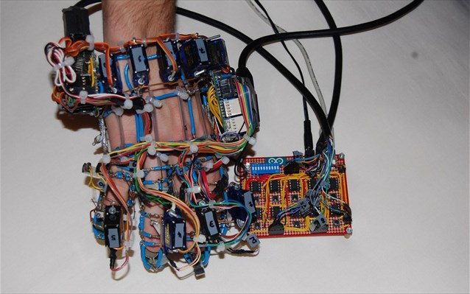
More details about the exoskeleton glove
This innovative device will be worn by the user as a glove. It detects human’s hand kinetic stimulus because of the pressure sensors that have been placed in the right spots and amplify it with the use of servo motors.

Slide 7
More details about the exoskeleton glove
Motion detection is achieved with the help of pressure sensors called FSR (Force sensing resistors) because they are made of a polymer material, which according to the external force applied on them alter their internal resistance. The analog signal from each sensor is directed to the 1st electronic circuit or Prototype Circuit Board (PCB). By using ten (1 for each movement) programmable microprocessors the analog signals from the 1st PCB are converted into digital.
The digital signals from the processing board enter the third PCB via a cable and then are split in order to control the precision motor mechanisms which are called servo motors. The exoskeleton glove was created so as to have the same degrees of freedom as the human palm, thereby not altering any of its physical movements.
Ioannou designed and programmed the three boards the glove consists of on his own with the help of an open source software called arduino. Due to the custom-built algorithm that used for his invention the exoskeleton glove can distinguish between arduous tasks, like toting a hammer, and more delicate moves, like holding an egg.

Slide 8
More details about the exoskeleton glove
Step 1
Ioannou realized that it was crucial the glove be fit almost perfectly onto the user’s hand, something which was successfully achieved.
Step 2
However the glove proved to be quite heavy, the servo motors that were included in the device were gradually getting hot and the sensors consumed a lot of time in order to work properly.
Step 3
Ioannou solved the arisen problems and suggested new ideas so as to maximize the effectiveness of his device.

Slide 9
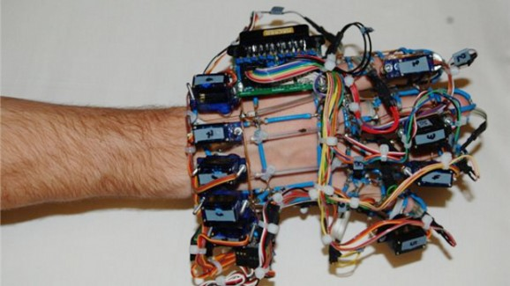
More details about the exoskeleton glove
Last but not least the glove was named “exoskeleton”, on account of the fact that Ioannou initially intended to construct it from a material such that all external forces act on the glove and not on the patient’s palm.
Lack of funding and technical knowledge urged Ioannou to use hard copper wire, which is cheap, easy to handle and can be bend into complex shapes for his device.

Slide 10
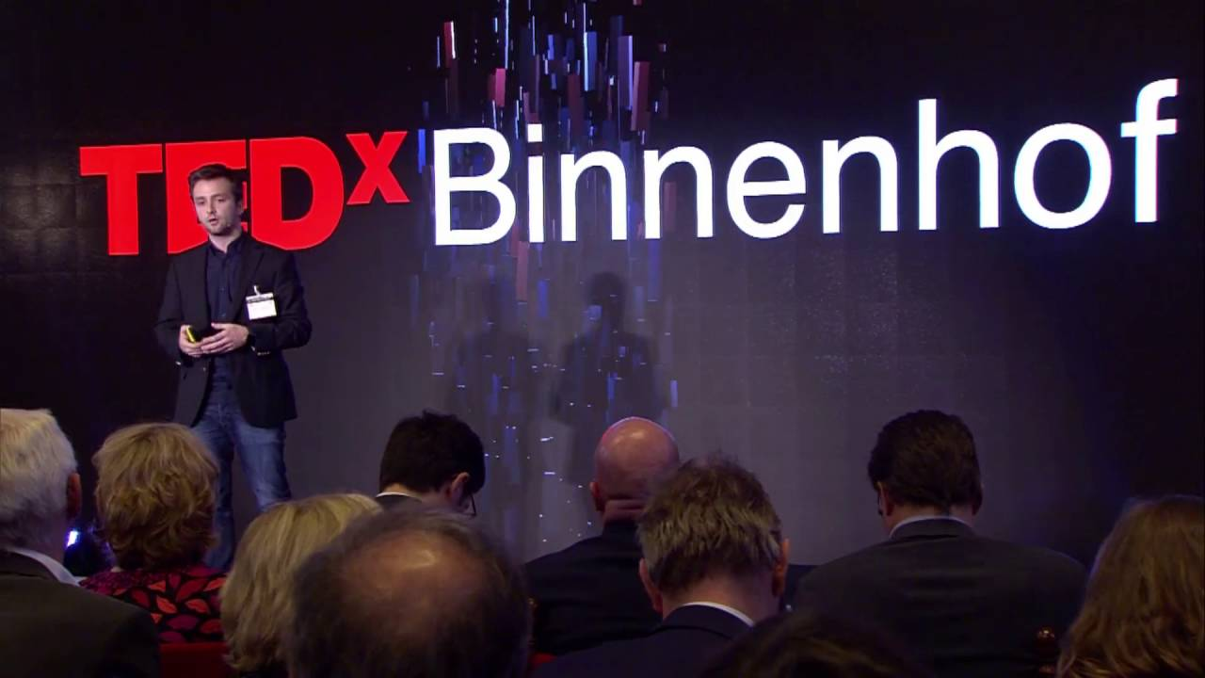
The awards and the honors of Charalampos Ioannou
2012
European Union’s competition for young scientists “The Best Engineering entry” (EUCYS 2012).
Annual Personality Award from UNICEF
1st Place, National Contest for Young Scientists
He managed to become the youngest TEDx speaker at Athens.
2013:
He earned one of 15 spots on the Google Science Fair. Later he became one of the 5 global finalists of this competition.
Invited Speaker at TEDx Athens.
Founding member of “BioAssist”
2015-2016:
Invited Speaker at EU's SME Assembly-Luxembourg
Invited Speaker at TEDx Binnenhof

Slide 11
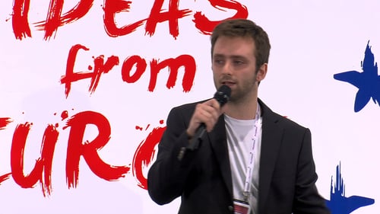
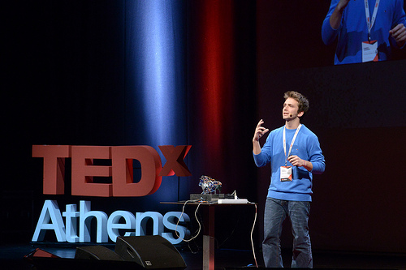
Charalambos Ioannou in the present
Charalambos Ioannou is currently making his degree in Electrical and Software Engineering at the National Technical University of Athens (NTUA). He is also a founding member of “Bioassist”, a company that applies state of the art software and machine learning algorithms in order to monitor vital health signal of independent living for the elderly.
Today, Charalambos Ioannou is the most promising scientist and pursues a great career, which is no surprise taking into consideration that even at the age of 9 had his own workshop, where he could transform his curiosity regarding how things function into innovative projects.

Slide 12
Conclusion
inventors of any age can design machines that will improve other people’s quality of life.
are combined with social awareness…
The conclusion we can reach is that when science, technology and creativity…

Slide 13
Bibliography
https://www.googlesciencefair.com/en/projects/ahJzfnNjaWVuY2VmYWlyLTIwMTJyQwsSC1Byb2plY3RTaXRlIjJhaEp6Zm5OamFXVnVZMlZtWVdseUxUSXdNVEp5RHdzU0IxQnliMnBsWTNRWW1hcHZEQQw (10-04-2018)
https://www.ellines.com/en/good-news/8091-ellinas-finalist-se-epistimoniko-diagonismo-tis-google/ (10-04-2018)
https://www.ellines.com/en/erga-ellinon/3845-diethnes-brabeio-gia-ti-suskeui-enischusis-kiniseon-palamis/ (10-04-2018)
http://www.businessinsider.com/this-greek-teen-is-developing-an-iron-man-hand-2013-6 (10-04-2018)
https://io9.gizmodo.com/this-18-year-old-invented-an-exoskeleton-glove-for-the-1341465319 (10-04-2018)
https://ideasfrom.eu/greece-charalamposioannou-bioassist/ (10-04-2018)
http://www.ekathimerini.com/153480/article/ekathimerini/community/greek-teen-develops-exoskeleton-glove (10-04-2018)
https://patient-innovation.com/post/1204?language=en (10-04-2018)
http://www.iflscience.com/technology/awesome-teenage-innovations-deserve-showcasing/ (10-04-2018)
https://bioassist.gr/ (10-04-2018)
https://heartaround.com/?lang=el (10-04-2018)

Slide 14
Videos
https://www.youtube.com/watch?v=7e42jSOSYMo(10-04-2018)
https://www.youtube.com/watch?v=iItHwVF0feo (10-04-2018)
https://www.youtube.com/watch?v=Kxa-2zuzyig (10-04-2018)
https://www.youtube.com/watch?v=_rLHfTOPoMw(10-04-2018)
https://www.youtube.com/watch?v=cUkcUOKVRtU(10-04-2018)

Slide 15
Thank you for your attention!

