Slide 1
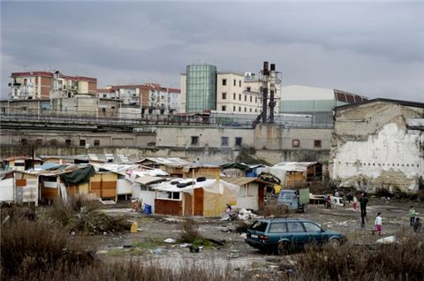
ECONOMIC CRISIS MIGHT BRING BACK A TOTALITARIAN REGIME
The main cause of the Italian economic crisis is the public debt.
The increment of taxes is causing discontent and disappointment towards politicians
The economic crisis gets the population to carry out protests against politicians and the European Commission
The unemployment and the lack of attention towards some areas of the country triggers crime
The loss of trust towards the government is causing abstentionism
All these phenomena generate weakness in the population and the government, which calls for a need for someone who can take the Country out of the crisis
As a result, the opportunity for a single man or a single party to gain all the power is easier and easier
Notes:
1

