Slide 1
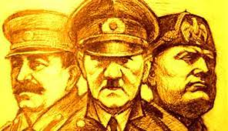
The populism
The populism was born in Russia in 1800, in opposition to statist bureaucratism and western industrialization
The regimes such as the fascist, nazi and bolshevik are an example of populism
They were able to exploit the emotions and interests of millions of men and women, changing and deceiving them…
Causes
Stressed , angry , frustrated and paranoid citizens
How do you react to populism?

