Slide 1
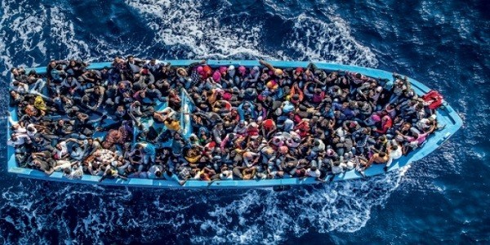
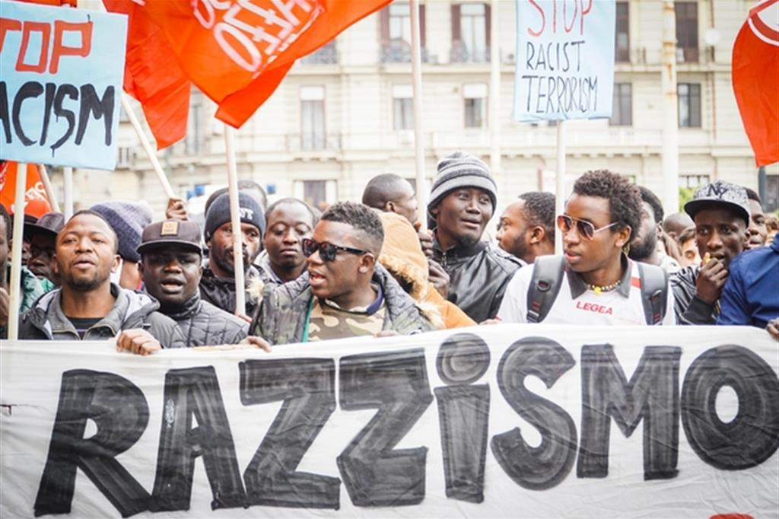
IMMIGRATION: A CAUSE FOR THE RETURN OF TOTALITARISM
ITALY IT’S THE COUNTRY MORE AFFECTED BY IMMIGRATION BECAUSE OF ITS POSITION. IT WORKS LIKE A PORT FOR THE WHOLE EUROPE.
THIS DISCOMFORT CAUSES A LOT OF CONFLICTS AND FEAR.
POLITICIANS SPECULATE ON THE TOPIC TO GAIN CONSENTS AND MASS MEDIA SPREAD FAKE NEWS TO GENERATE PANIC AND VIEWS.
RACISM
PEOPLE ARE AFRAID BY WHO CAME FROM ANOTHER COUNTRY BECAUSE THEY THINK THAT THEY COME TO ITALY JUST TO STEAL THEIR JOBS OR TO MAKE VIOLENCE.
THEY NEED SOMEONE WHO SAYS TO THEM THAT HE WILL STOP THE FLOW OF IMMIGRANTS TO ITALY.
THIS PROCEEDINGS ARE THE CAUSES OF
FEAR OF TERRORISM
THE RECENTS ATTACK OF TERRORISM AROUND THE EUROPE BROKE OUT OF THE POSSIBILITITY THAT TERRORISTS CAN COME TO ITALY THROUGH THE IMMIGRATION FLOW.
ALSO IN THIS CASE THE POPULATION NEED SOMEONE WHO MAKE THEM BELIEVE THAT HE CUT OFF EVERY IMMIGRANT EVEN IF HIS INTENTIONS ARE UNKNOWN.
ECONOMIC FACTOR
THE AMOUNT OF IMMIGRANTS THAT ARRIVES TO ITALY IS UNMANAGEABLE.
POPULATION IS CONVINCED THAT THEY ARE IN BETTER CONDITIONS THEN THEM SO ONCE AGAIN THEY NEED SOMEONE AGAINST IMMIGRATION.
ALL THIS PROBLEMS ARE CAUSED BY IGNORANCE.
WE HAVE TO FIGHT AGAINST IT TO PREVENT THE RETURN OF A TOTALITARIAN REGIME.

