Slide 1
Junta in Greece during 1967-1974
And the main reasons behind it

Slide 2
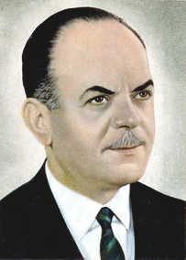
The main events
The Greek military Junta started in 1967 and ended in the year 1974.
It is also known as Regime of the Colonels.
One of the most significant persons throughout the
Greek Junta was George Papadopoulos.

Slide 3
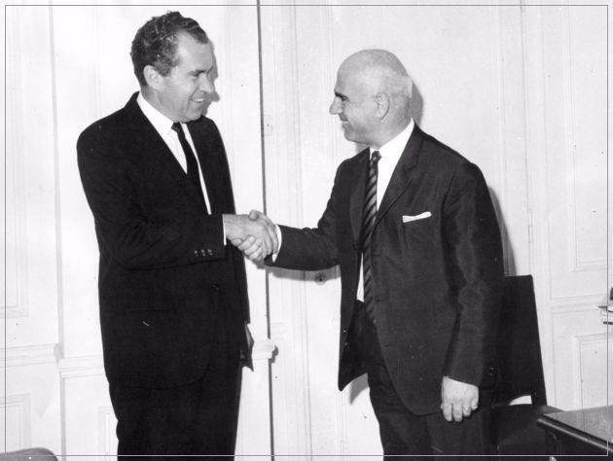
Why the government of America was in favour of Junta
The fear that Greece would become a communist country - in the elections of 1958 EDA took the 2nd place.
The issue of Cyprus.
Greece might have left the NATO.

Slide 4
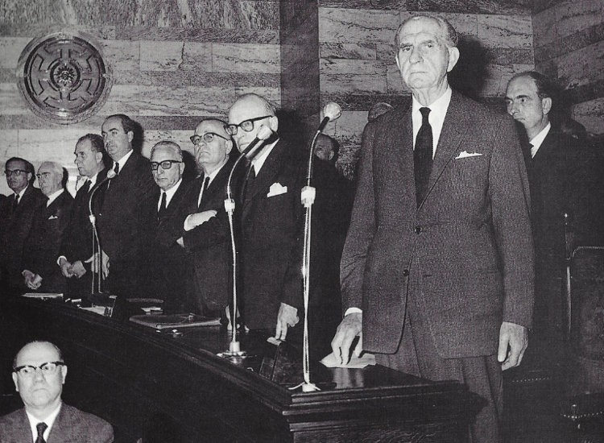
Prime Minister George Papandreou was forced to resign and the elections were postponed.
The young and inexperienced King Constantine decided to form a government with ministers from G. Papandreou’s party , who were called apostates.
A period of political instability begun.
The crisis of 1965

Slide 5
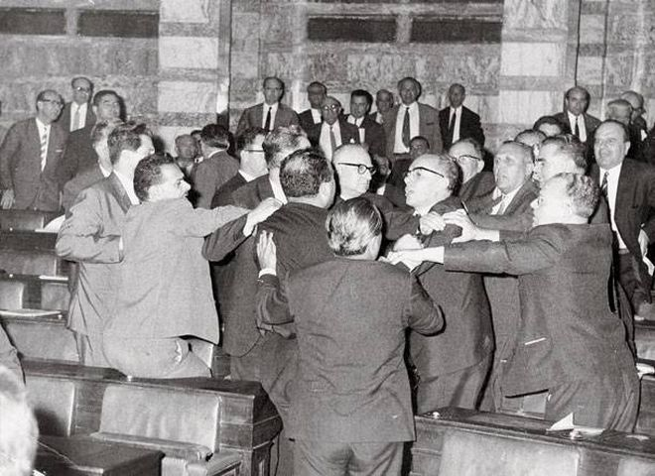
Political instability
The government of Papandreou - July of 1965
The government of Stefanopoulos - December of 1966
Postponed elections
Government service of Paraskevopoulos
Postponed elections
political deadend
Coup d'etat of 21st of April

Slide 6
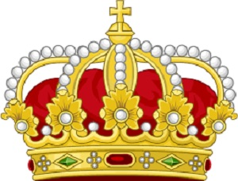
Role of the King
Tanks came to Athens (21st April).
King Constantine was asked to mobilize the state against the Coup
He was isolated that day.
He claimed he needed time to start the counter-coup.
Did he organize a counter-coup d’ etat indeed?He did nothing.
The King later regreted his decision bitterly.
For many Greeks,he is associated to the coup d’etat.That certainly played an important role in the final decision of people to abolish monarchy, through the 1974 referendum.

Slide 7
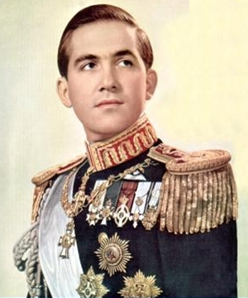
King's counter-coup d’ etat
Launched in December 13, 1967.
His plan to invade and take control over Thessaloniki.
He failed. Junta wanted him dead.
They searched for him in Kavala.
Junta ridiculed Constantine by announcing that he was hiding "from village to village". Realising that the counter-coup d’ etat had failed, Constantine left Greece.

Slide 8
Regency
The flight of Constantine and Kollias left Greece with no legal government or head of state. So there was no king.
Junta became the only government of Greece.
During this period, resistance against the colonels' rule became better organized among exiles in Europe and the United States.
There was also considerable political fight among the members of the junta government.
Still, up until 1973, Junta had a total control of Greece and it seemed unlike that it could be abolished through violent means.

Slide 9
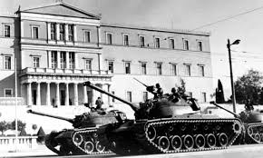
The results
A dark political period for Greece.
Civil rights were suppressed.
Many young people died for freedom.
Τhe Turkish invasion of
Cyprus (1974).

Slide 10
Thank you for your attention
Sophia Kafira, Chrysoula Stavridou, Nikos Kefalidis, Thodoris Velisaridis, Anna Karakosta

