Slide 1
Causes of totalitarianism in poland in the past
Liceum Ogólnokształcące nr 5, Wrocław, Poland

Slide 2
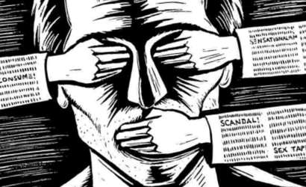
totalitarianism
Totalitarianism is defined as a form of government in which any opposition is prohibited and all aspects of public and private life are controled by the state. It is the most extreme form of authoritarianism. In a totalitarian regime the power is held either by one main political party or by a dictator. Political pluralism, freedom of religion or speech are not allowed. The government spreads propaganda, misinformation and controls the media. The economy is also ruled by the state. Any individual or party that is considered to be an ’’enemy of the state’’ can be politically repressed, even sentenced to death.

Slide 3
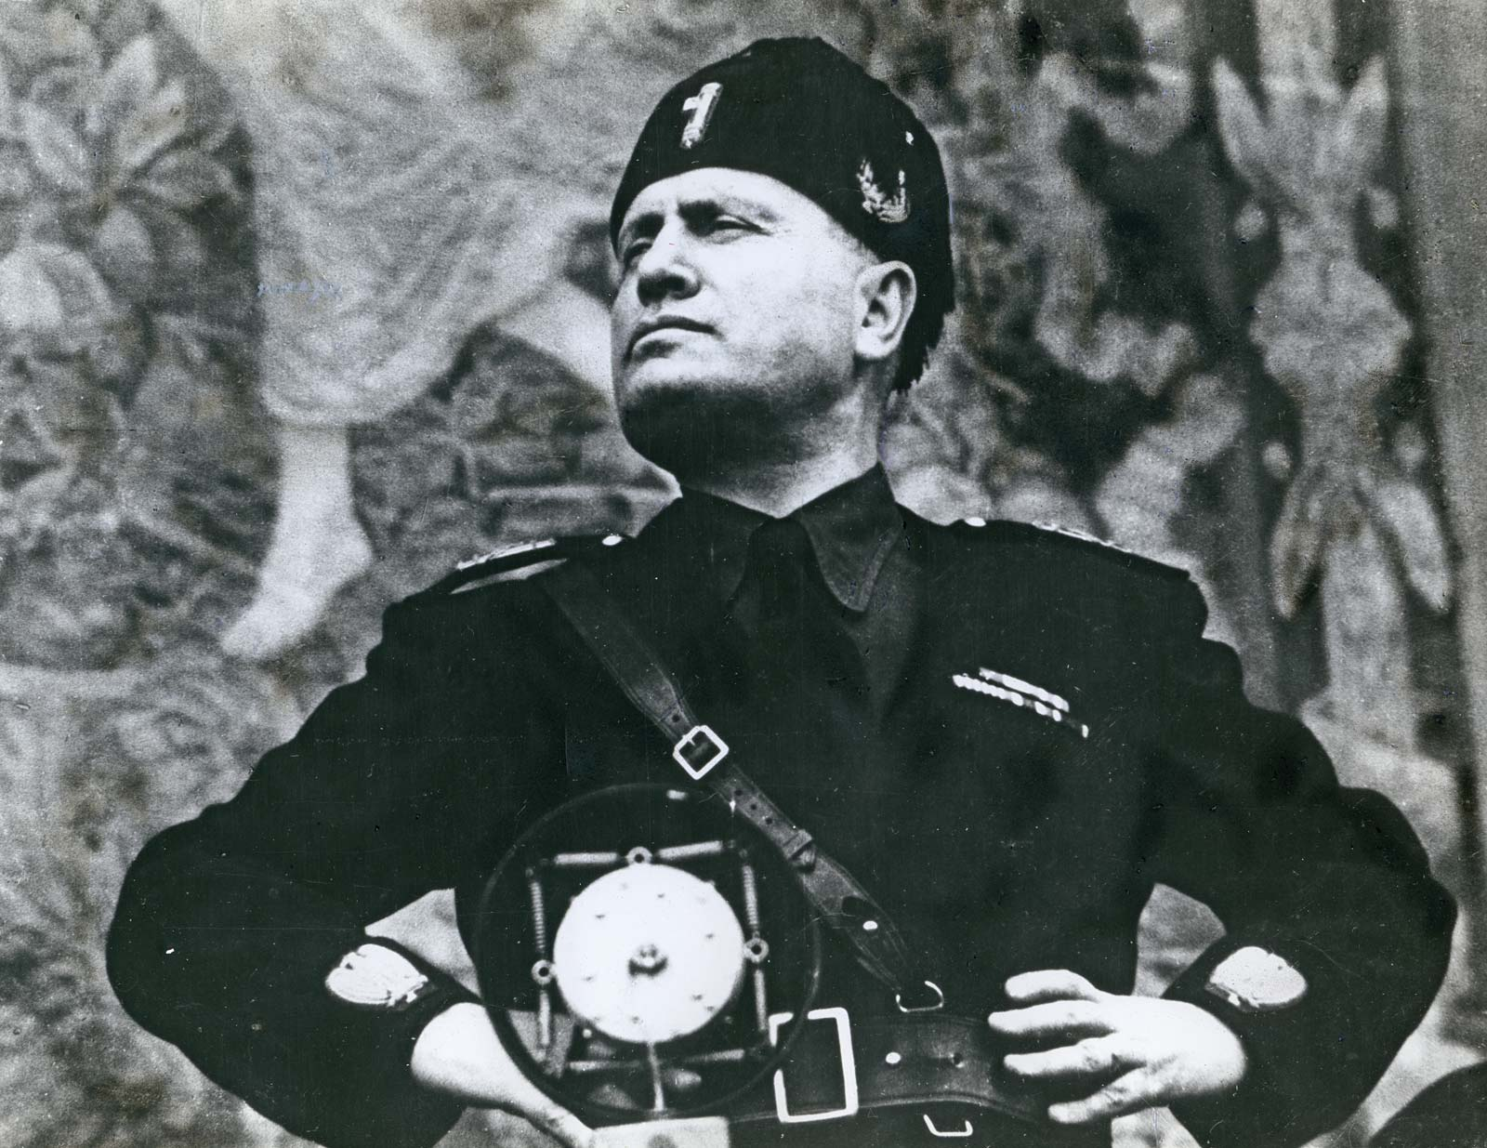
Examples of Totalitarian regimes and their leaders throughout history
Fascist Italy (1922 – 1943) – Benito Mussolini

Slide 4
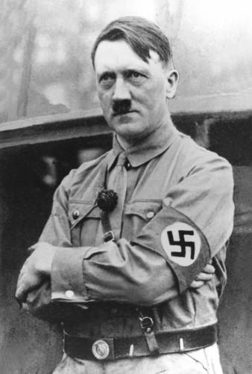
examples of Totalitarian regimes and their leaders throughout history
Nazi Germany (1933 – 1945) – Adolf Hitler

Slide 5
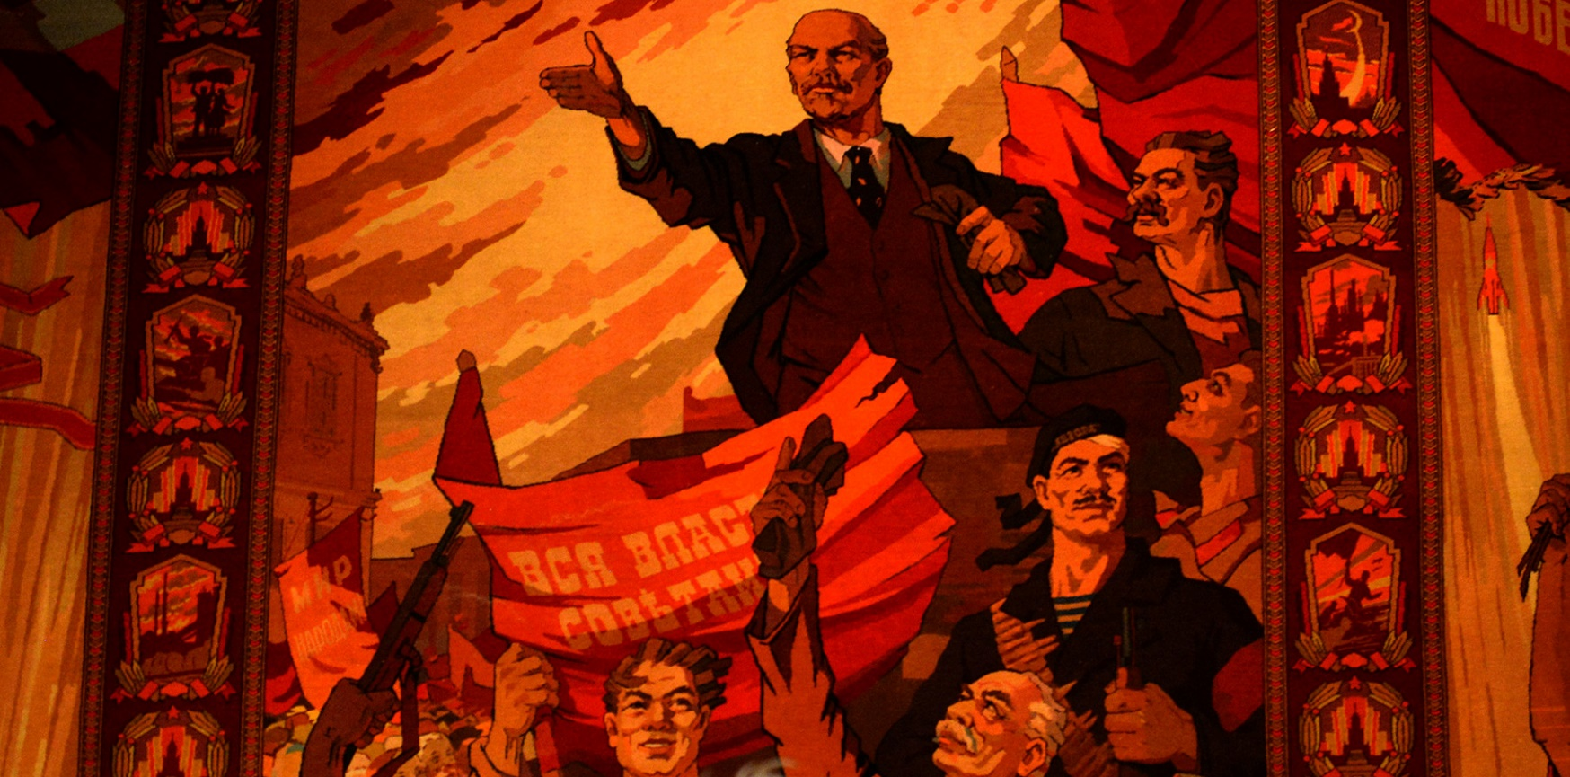
examples of Totalitarian regimes and their leaders throughout history
The Soviet Union (1922 – 1990) – governed by the communist party

Slide 6
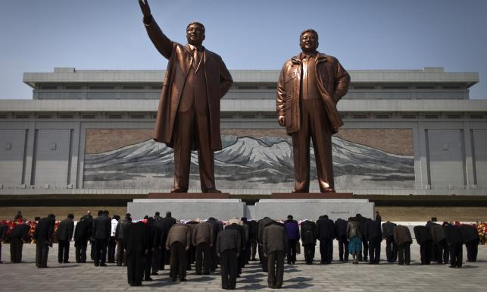
examples of Totalitarian regimes and their leaders throughout history
North Korea (1948 – present) – governed by one party with dictator (currently Kim Jong – Un)

Slide 7
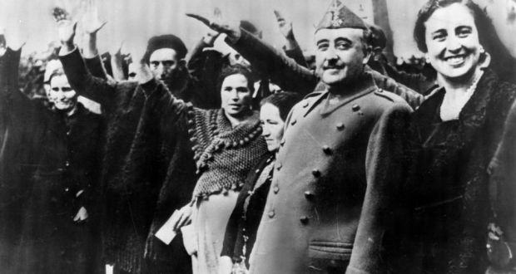
examples of Totalitarian regimes and their leaders throughout history
Francoist Spain (1936 – 1975) – Francisco Franco

Slide 8
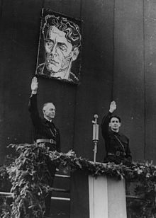
examples of Totalitarian regimes and their leaders throughout history
National Legionary State in Romania (1940 – 1941) – Ion Antonescu

Slide 9
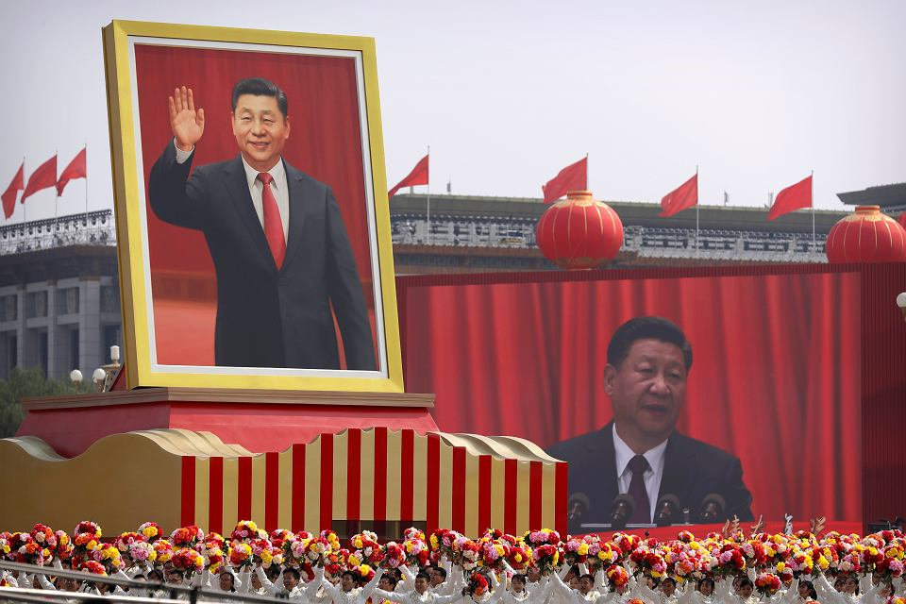
examples of Totalitarian regimes and their leaders throughout history
People’s Republic of China (1949 – 1976) – governed by the communist party

Slide 10
Why countries BECAME TOTALITARIAN?
Throughout history various countries developed totalitarian governments.
In Italy, for example it was due to the population’s anger and dissatisfaction with badly excecuted democracy and failing economy.
In The Third Reich the Germans were feeling unjustice after losing World War I.
In the USSR people were (at first) encouraging the socialistic movements that promised equality and well-being for everyone.

Slide 11
totalitarianism in the ussr
Before we get to totalitarianism in Poland we have to disclose that it was caused by the USSR government spreading its ideology.
After the 1917 revolution The Bolsheviks (lead by Lenin) took over. After Lenin’s death in 1922 Stalin ruled the communist party. In 1928 the real terror started – any opponents (civilians or polititians) were facing trials and being convicted, sent to concentration camps or sentenced to death.
The USSR remained as a totalitarian government even after World War II and gained control over the middle and eastern Europe.

Slide 12
Poland forced to have a communist government
That is how The Polish People’s Republic (Polska Rzeczpospolita Ludowa) was created. It had a communist government imposed by Russia, which was decided during the Yaltan Conference in 1945.
Because the government had to be legitimised by a democratic voting, the elections were falsified. The results weren’t questioned by other countries that had a say in the reorganisation of Poland, which lead to the creation of a legal communist government.
Stanisław Mikołajczyk, the previous prime minister was under the threat of being arrested forced to leave the country.

Slide 13
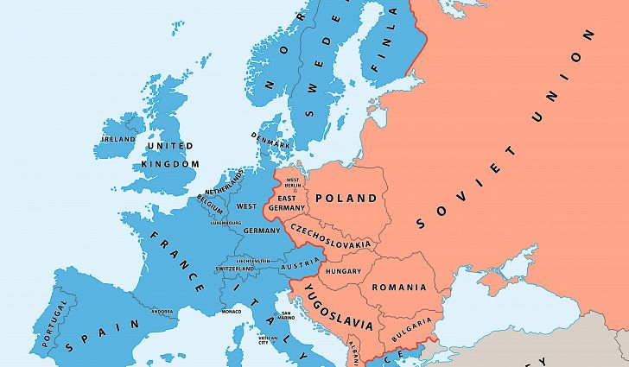
The iron curtain
After the 1945 Yaltan Conference the world was „split in two’’. The Iron Curtain was a non – phisical boundary deviding Europe into two areas. It remained like that until the end of the Cold War in 1991.
In the east were countries connected to or influenced by the Soviet Union and in the west – countries who were either NATO members or neutral.

Slide 14
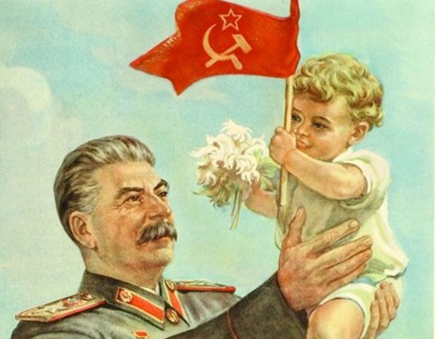
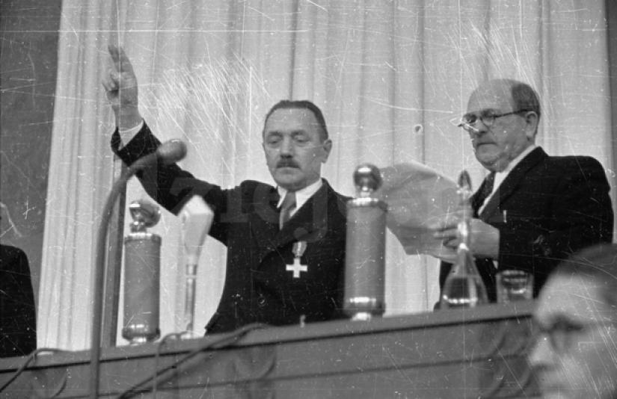
stalinism
Poland has not always been the way it is now. Even though we were born and live in a democratic country, it wasn’t always like that. Even our parents grandparents remember how different life in Poland looked not so long ago.
The period of Polish history between 1948 and 1956 is described as stalinism. Stalinism was an ideology developed in 1927 in the Soviet Union named after the communist leader Joseph Stalin. It included collectivisation and industrialisation, the theory of socialism as well as a cult of personality (of Stalin).

Slide 15
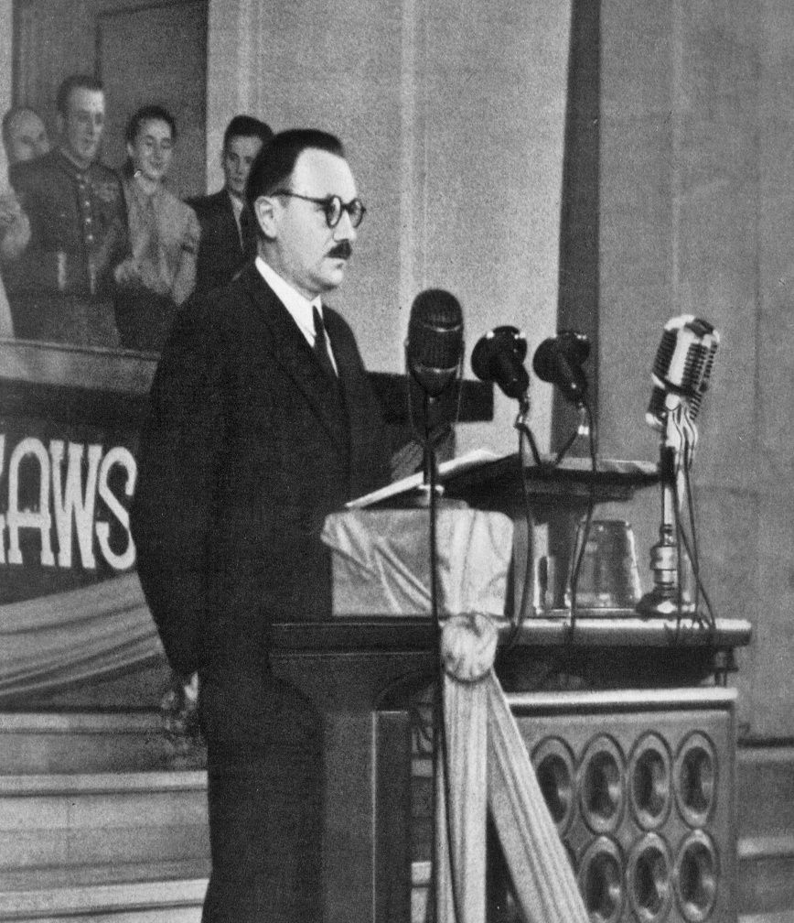
Totalitarianism in poland
Bolesław Bierut (1892 – 1956) was a Polish communist leader. Firstly, in 1944 he became president of the State National Council. Then, between1947 and 1952 he was president of Poland and General Secretary of the Polish United Workers’ Party. He is known for implementing the stalinist policies in Poland, using violence and political repressions in order to keep his position.
Polish Institute of National Rememberance states that in between 350 000 and 400 000 were directly affected by his reign.

Slide 16
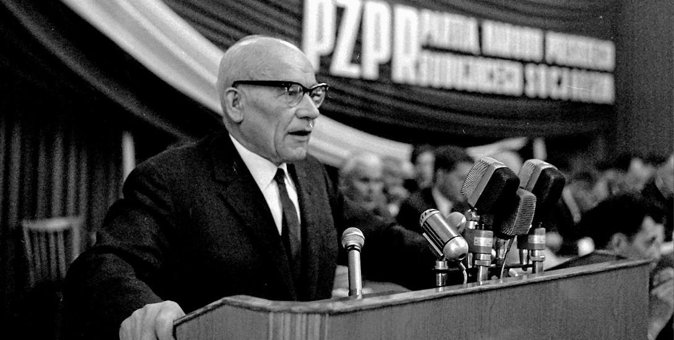
Totalitarianism in poland
Władysław Gomułka (1905 – 1982) in 1945 became a deputy prime minister in the Provisional Government of the Republic of Poland and was also a minister of Recovered Territories and Bierut’s biggest political rival. From his initiative the State National Council was created.

Slide 17
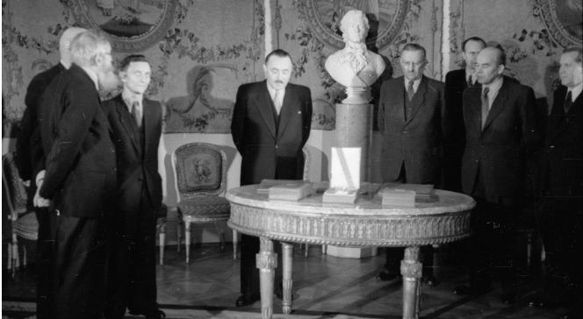
State national council
State National Council (Krajowa Rada Narodowa) was created in Warsaw in 1943, by the end of World War II. It was center of authority controlled by the communist goverment.

Slide 18
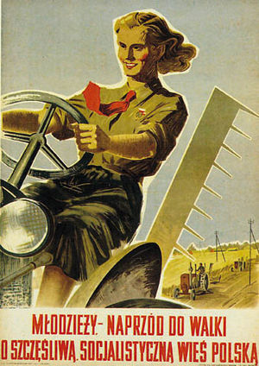
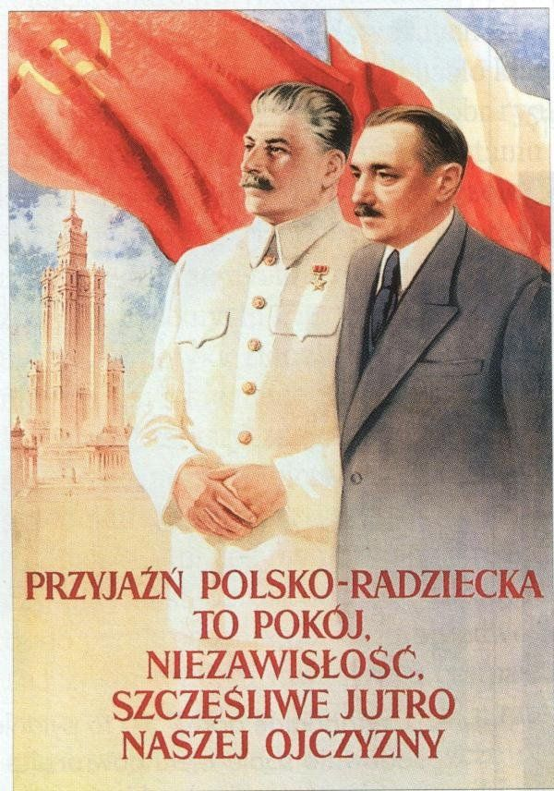
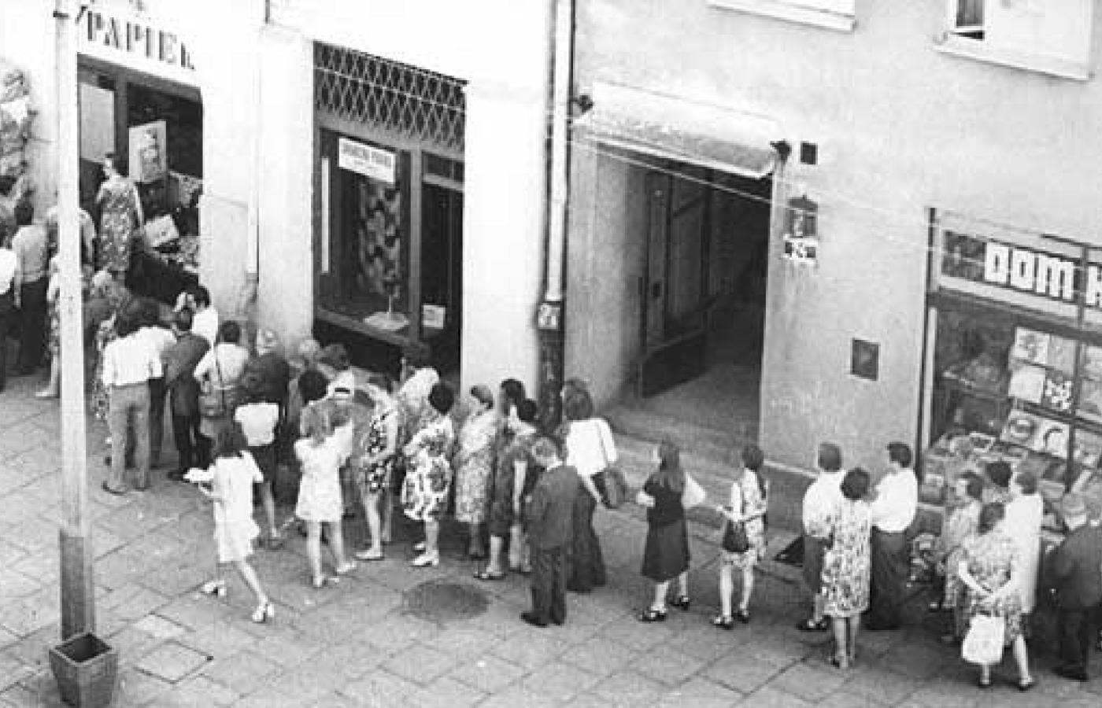
Totalitarianism in poland (1948 – 1956)
Planned economy
Planned agriculture
Almost complete control over media, censorship, utilising propaganda
Unfair elections

Slide 19
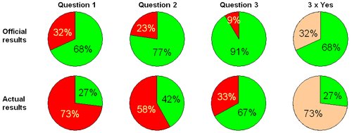
Forged referendum - 1946
On 30 June 1946 a Peoples’ Referendum was held in Poland. It was also known as the ’’Three Times Yes Referendum’’. The voters were asked three questions:
Are you in favor of abolishing the senate?
Do you want consolidation, in the future constitution of the economic system founded on agricultural reform and the nationalisation of basic national industries, including the preservation of the statutory rights of private enterprise?
Do you want consolidation of the western border of the Polish State?
The official results, announced by the communist party were compeletely different then the actual results.

Slide 20
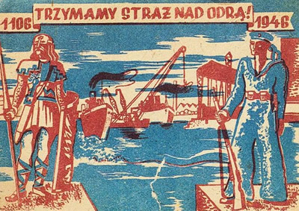
The polish workers’ party
The Polish Workers’ Party (Polska Partia Robotnicza) was created in 1942 as a reconstitution of the Communist Party of Poland (which ruled the country during the Second Polish Republic) responsible for spreading communism and state socialist system. The party’s military force was the People’s Guard.

Slide 21
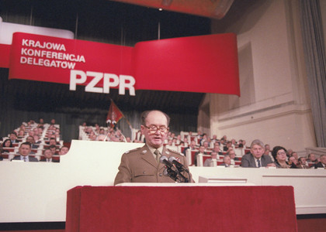
The polish united workers’ party
The Polish United Workers’ Party (Polska Zjednoczona Partia Robotnicza) was a communist monoparty established in 1948 by merging together the previously existing Polish Workers’ Party and The Polish Socialist Party. It was ideologically based on marxism leninism. The party’s military force was the Polish People’s Army. It’s first leader was Bierut. The party’s political programme had to do mostly with estabilishing a strong communist goverment in Poland as well as spreading the ideology to neighboring countries and the world in general.

Slide 22
The polish united workers’ party - programme
Planned economy and agriculture
Collectivisation, eradication of private property
Overtaking of private enterprises by the government
Prioritising the military industry
Political repressions

Slide 23
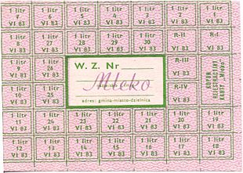
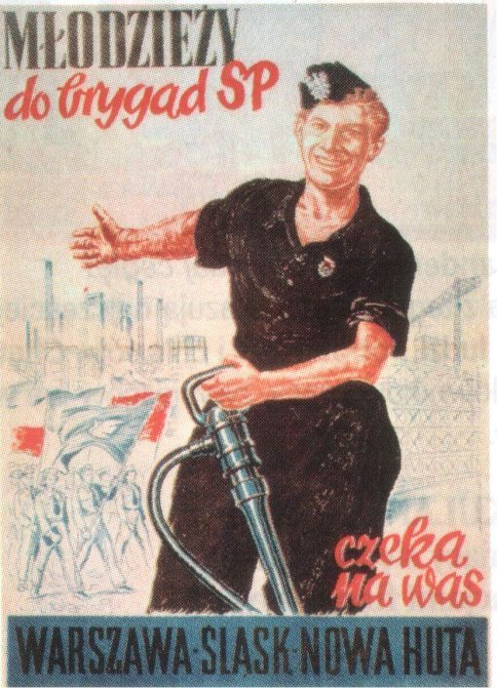
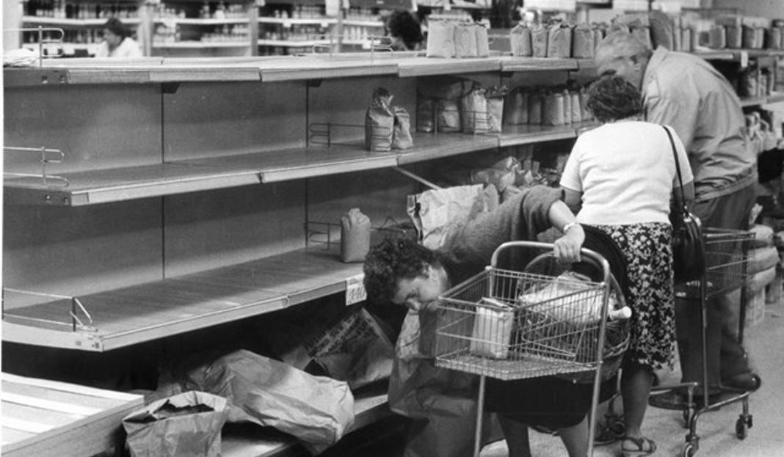
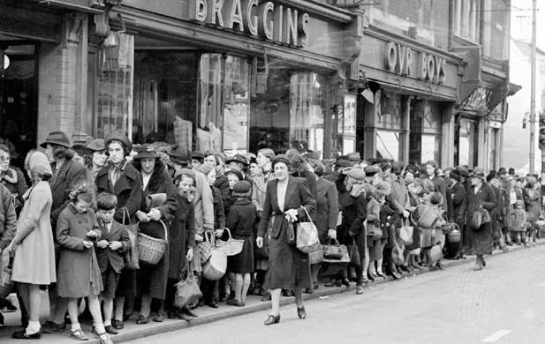
Daily problems during the communist Reign in poland (until 1989)
Common shortage in nessecities (such as food and basic articles)
Ever – present political propaganda and indoctrination of society (especially young people)
Poverty

