Slide 1
The causes of the establishment of the communist political regime in Romania

Slide 2
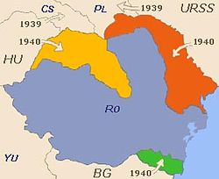
Romania’s Territorial Losses in 1940
Reasons for the losses are the Soviet ultimatum and the following decrees of the Hitler-Stalin pact, which force România to give up land to teritoriu The Soviet Union, Hungary and Bulgary.
România loses Bucovina De Nord, Ținutul Herței and Basarabia (to The Soviet Union), North Transilvania (to Hungary) and Cadrilater (to Bulgary).
These territorial losses represent the destruction of “Romania Mare”.
Basarabia, Bucovina de Nord – 26-28 June 1940
Transilvania de Nord, Maramures, Crisana – 30 August 1940 – The Vienna Decree
Cadrilater – 7 September 1940 – The Craiova Agreement

Slide 3
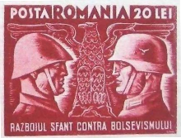
Romania’s Entrance Into World War II
On 22 June 1941, Natzi armies with Romanian support attacked the Soviet Union. Natzi and Romanian units conquered Bessarabia, Odessa, and Sevastopol, then marched eastward across the Russian steppes toward Stalingrad. Romania welcomed the war because they were allies with Germany.
In the immediate wake of the loss of Northern Transylvania, on 4 September the Iron Guard (led by Horia Sima) and General (later Marshal) Ion Antonescu united to form the “National Legionary State”, which forced the abdication of Carol II in favor of his 19-year-old son Mihai (Carol went into exile).
Romania officially joined the the Axis powers on 23 November 1941.
Romanian stamp from 1941. The text reads
“the holy war against Bolshevism”

Slide 4
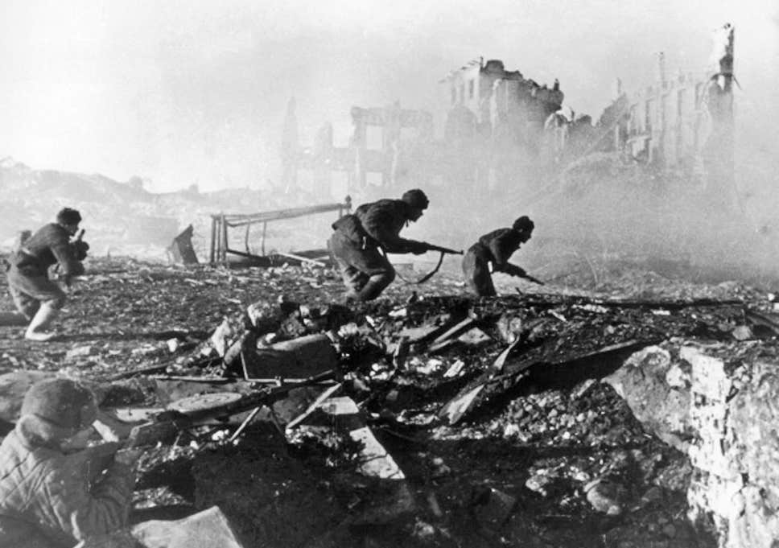
The Battle Of Stalingrad
Romanian armies advanced far into the Soviet Union during 1941 and 1942 before being involved in the disaster at the Battle of Stalingrad in the winter of 1942–43.
General Petre Dumitrescu was commander of the Third Army at Stalingrad. In November 1942, the German Sixth Army was briefly put at Dumitrescu's disposal during a German attempt to relieve the Third Army following the devastating Soviet Operation Uranus.
Prior to the Soviet counteroffensive at Stalingrad, the Antonescu government considered a war with Hungary over Transylvania an inevitability after the expected victory over the Soviet Union.

Slide 5
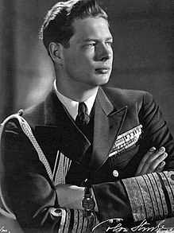
King Mihai’s “coup d’etat”
On 23 August 1944, With the support of several political parties, the king removed the government of Ion Antonescu, which had aligned Romania with Nazi Germany, after the Axis front in northeastern Romania collapsed in the face of a successful Soviet offensive.
The coup was supported by the Romanian Communist Party, the Social Democratic Party, the National Liberal Party, and the National Peasants' Party who had coalesced into the National Democratic Bloc in June 1944.
King Mihai I in 1947

Slide 6
King Mihai’s “coup d’etat”
According to Silviu Brucan, the two main conspirators from the Communist Party's side were Emil Bodnăraș and Lucrețiu Pătrășcanu, who contacted King Mihai to prepare a coup d'état against Ion Antonescu. The first meeting between Mihai’s representatives with the Communists was during the night of 13–14 June 1944 in a secret house of the communists, at 103 Calea Moșilor, in Bucharest.
On 23 August 1944 King Mihai joined with pro-Allied opposition politicians and led a successful coup with support from the army. Michael, who was initially considered to be not much more than a "figurehead", was able to successfully depose dictator Ion Antonescu.
The king offered a non-confrontational retreat to German ambassador Manfred Freiherr von Killinger, but the Germans considered the coup "reversible" and tried to turn the situation around by military attacks. The Romanian First Army, the Romanian Second Army (under formation), the remnants of the Romanian Third Army and the Romanian Fourth Army (one corps) were under orders from the king to defend Romania against any German attacks.
The king then offered to put Romania's battered armies on the side of the Allies.

Slide 7
The Aftermath Of The “coup d’etat”
The coup sped the Red Army's advance into Romania. Romanian historians claimed that the coup shortened the war by as much as "six months."
Formal Allied recognition of the de facto change of orientation of Romania in the war came on 12 September 1944. Until this date, Soviet troops started moving into Romania, taking approximately 140,000 Romanian prisoners of war. About 130,000 Romanian prisoners were transported to the Soviet Union, where many perished in prison camps.
Soviet troops entered Bucharest on 30 August 1944.

Slide 8
The “Shares Of Influence”
In October 1944, Winston Churchill, Prime Minister of the United Kingdom, proposed an agreement with Soviet leader Joseph Stalin on how to split up Eastern Europe in spheres of influence after the war. It was reportedly agreed that Soviet Union would have a “90% share of influence” in Romania, while the West only had a “10% share of influence“.
The Percentages agreement - 1944

Slide 9
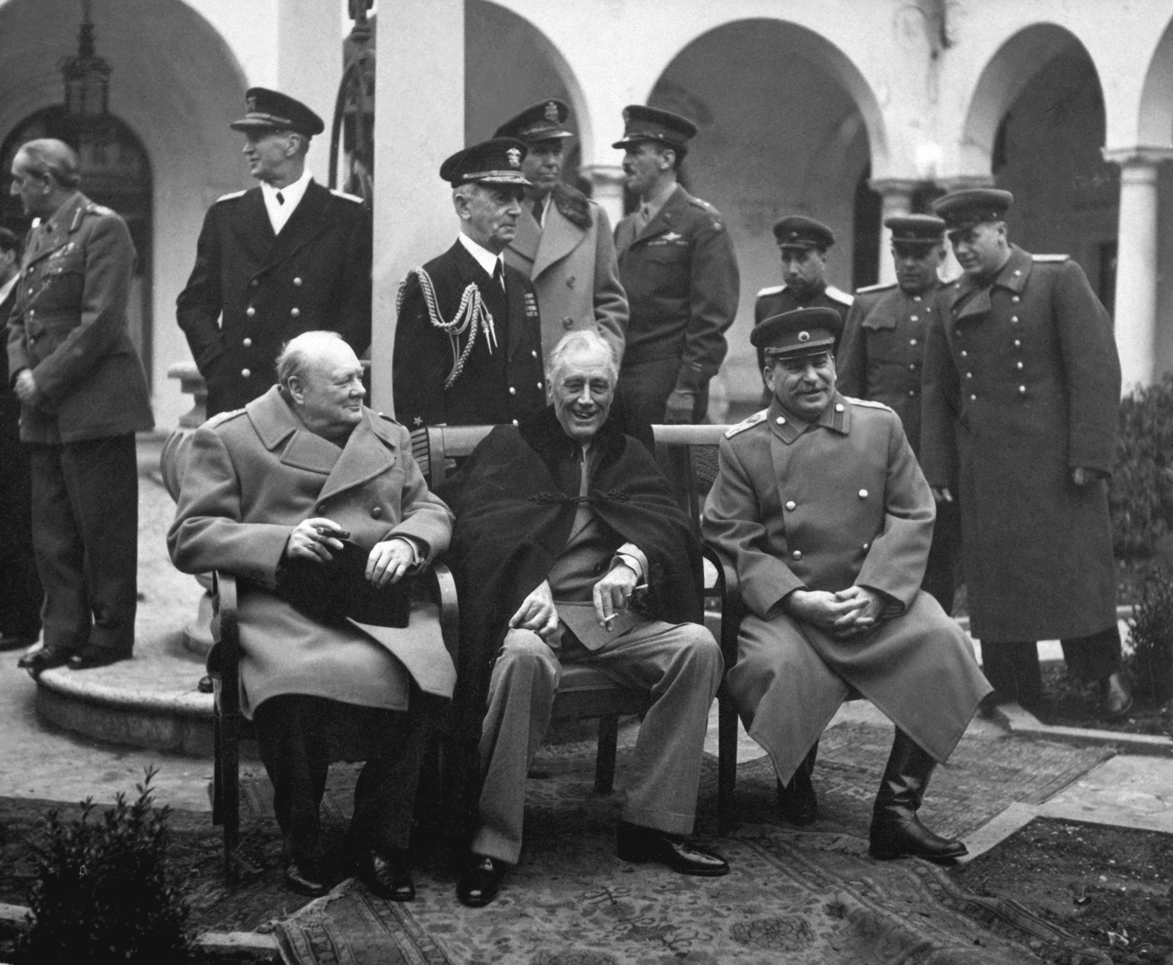
The Yalta Conference
Yalta Conference, held February 4–11, 1945, was the World War II meeting of the heads of government of the United States, the United Kingdom, and the Soviet Union to discuss the postwar reorganisation of Germany and Europe.
The three states were represented by President Franklin D. Roosevelt, Prime Minister Winston Churchill, and Premier Joseph Stalin, respectively.
The conference was held near Yalta, in Crimea
The aim of the conference was to shape a post-war peace that represented not just a collective security order but a plan to give self-determination to the liberated peoples of post-Nazi Europe.
A consequence of the conference was that the people get to choose the form of political organzation.
Winston Churchill, Franklin D. Roosevelt and Joseph Stalin, 1945

Slide 10
popoarele isi aleg forma de organizare politica

Slide 11
Falsification of the 1946 elections
Breaking with the traditional male only right to vote confirmed by the 1923 Constitution, it was the first national election to feature women’s right to vote, and the first to allow active public officials and army personnel the right to vote.
General elections were held in Romania on 19 November 1946, in the aftermath of World War II. The official results gave a victory to the Romanian Communist Party (PCR) and its allies inside the Bloc of Democratic Parties. The event marked a decisive step towards the fall of the Romanian monarchy and the proclamation of a Communist regime at the end of the following year.

Slide 12
The aftermath of the elections
In the following months, communists concentrated on silencing the other parties and ensuring to dominate the political field.
In the summer of 1947, the Tămădău Affair saw the end of the PNŢ. It was banned after Iuliu Maniu and others were prosecuted during trial. PNL, which critiqued the Groza administration around the same time, was forced out of the government as well, only to be implicated in the Tămădău scandal. It had its leadership replaced later on with ones more loyal to the PCR.
The PCR ultimately merged with the PSD in late 1947 to form the Romanian Workers' Party (PMR)

Slide 13
King Mihai’s I forced abdication
Early on the morning of 30 December 1947, Mihai was preparing for a New Year's party at Peles Castle in Sinaia, when Groza summoned him back to Bucharest. Him and Communist Party leader Gheorghe Gheorghiu-Dej were waiting for him, and demanded that he sign a pre-typed document of abdication. Unable to call in loyal troops, due to his telephone lines allegedly being cut, and with Groza holding a gun on him, Michael signed the document
Later the same day, the Communist government announced the permanent abolition of the monarchy, and its replacement by a People’s Republic, broadcasting the King's proclamation of his abdication.
Abdication act, 1947

Slide 14
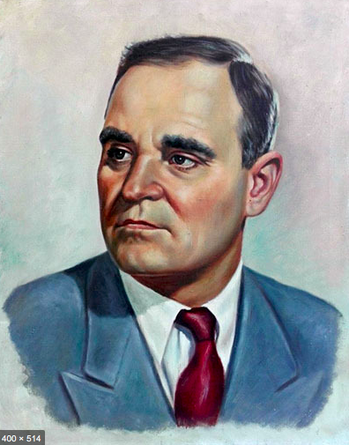
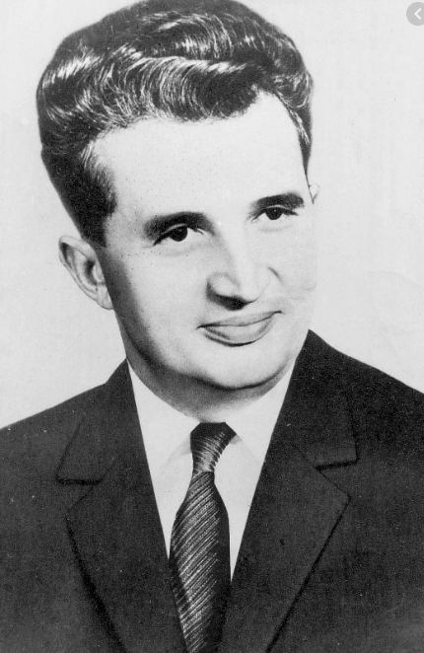
Gheorghe Gheorghiu-Dej
Head of the communist party from 1948 until 1965
Nicolae Ceausescu
Head of the communist party from 1965 until 1989

